Slide 1
SUBSCRIPTION CHURN ANALYSIS
TEAM MEMBERS:
PUSHPESH KUMAR SAH
GIRISH K
AKSHAY RAJU ACHARI

Slide 2
Customer Churn?
Customer churn refers to when customers stop using a company's product or services.
Example: Netflix , Amazon Prime subscription.
Why it matters:
Losing customers reduces company revenue
Understanding churn helps companies improve customer retention

Slide 3
Dataset Source & Overview:
The dataset used for this analysis is the Telco Customer Churn Dataset.
Source: https://www.kaggle.com/datasets/blastchar/telco-customer-churn/data?select=WA_Fn-UseC_-Telco-Customer-Churn.csv
Code link: https://colab.research.google.com/drive/1v6BitGFwMh-wq4TZWfttN6Pfp1DNuJ8m?usp=sharing

Slide 4
Objective of the Analysis:
The objective of this analysis is to explore customer data and identify patterns that influence customer churn.
What percentage of customers have churned?
What factors influence customer churn?
How do customer demographics affect churn behavior?
Does service type or contract type impact churn?
Do pricing factors such as monthly charges affect churn?

Slide 5
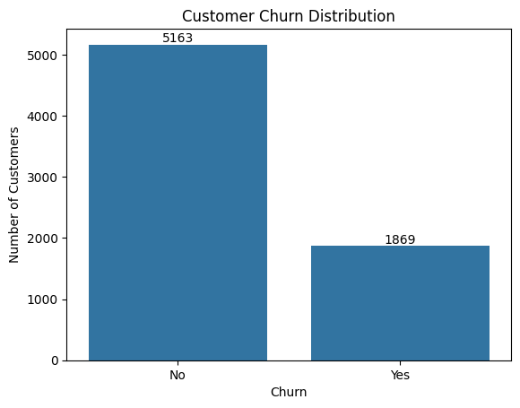

Slide 6
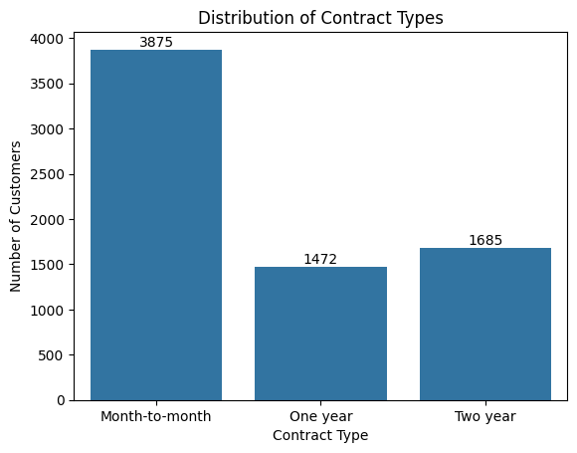

Slide 7
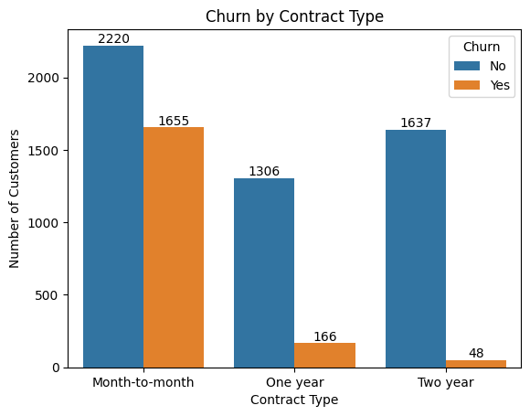

Slide 8
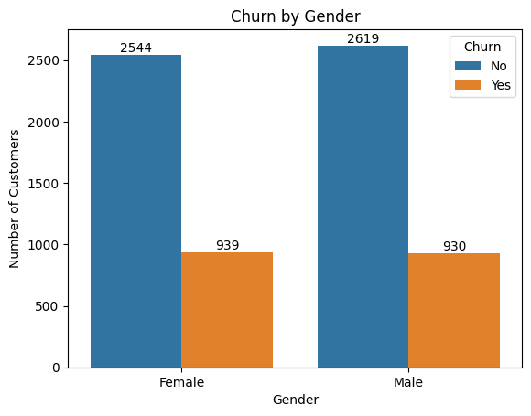

Slide 9
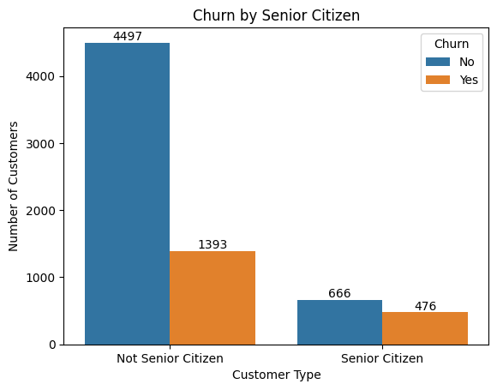

Slide 10
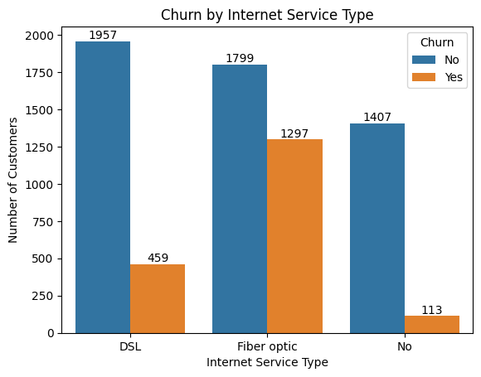

Slide 11
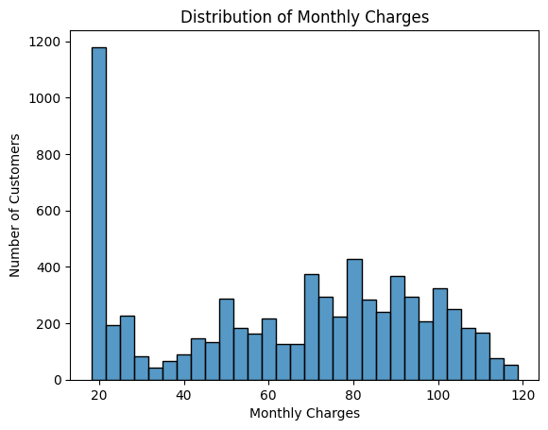

Slide 12
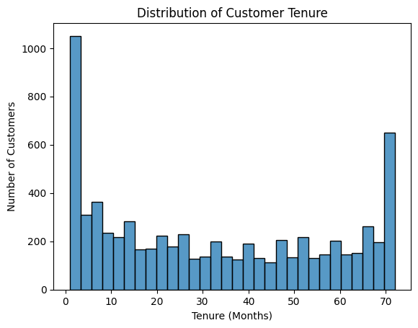

Slide 13
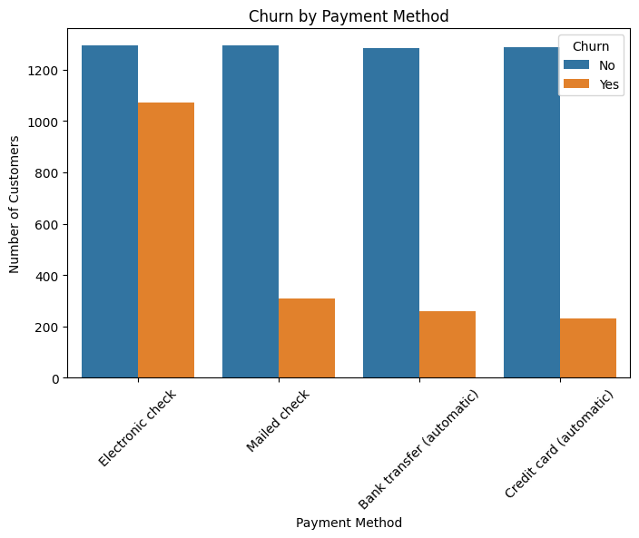

Slide 14
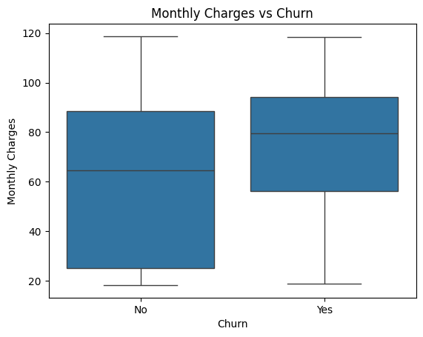

Slide 15
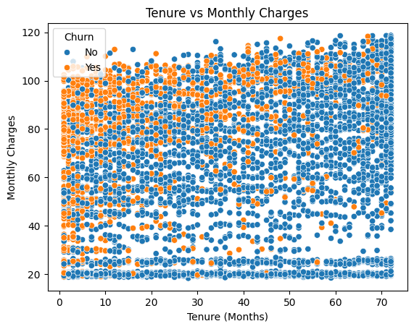

Slide 16
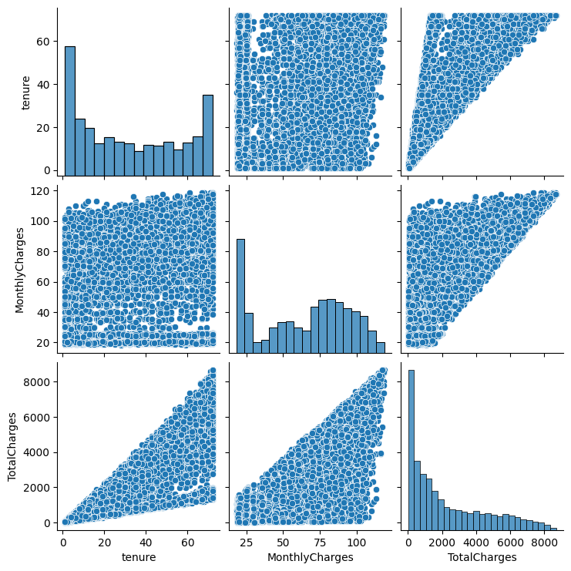

Slide 17
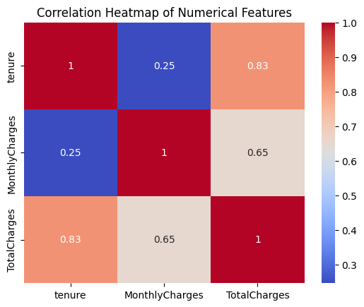

Slide 18
CONCLUSION
Around 26% of customers have churned, showing a noticeable churn rate.
Customers with month-to-month contracts show the highest churn compared to long-term contracts.
Customers with shorter tenure are more likely to churn, meaning new customers leave more frequently.
Customers paying higher monthly charges tend to churn more than those with lower charges.
Certain payment methods such as electronic check show higher churn rates.

Slide 19
RECOMMENDATIONS
Encourage customers to choose long-term contracts by offering discounts.
Improve customer onboarding for new customers to reduce early churn.
Promote automatic payment methods to improve retention.
Review pricing strategies for high monthly charge plans.

Slide 20


